Slide 1
Natural
Language
Processing
NLP

Slide 2
Uses of Natural Language Processing classifiers in the real world.
Detecting if an email is spam or not.
Classifying what type of news an article is.
Sentiment Analysis, is this text saying something negative or positive.

Slide 3
Turning words into numbers.
We need a way to represent text numerically in order to perform math with them and build machine learning models.
There are two main ways of doing this.
Bag of Words (BOW)
Term Frequency - Inverse Document Frequency (TF-IDF)
There is another called Word2Vec, however, we will not be covering that in this lecture. To learn more about W2V here, and here.

Slide 4
Bag-of-Words
A bag of words is a collection of words that represent a document along with the word count where the order of occurrences is not relevant.

Slide 5
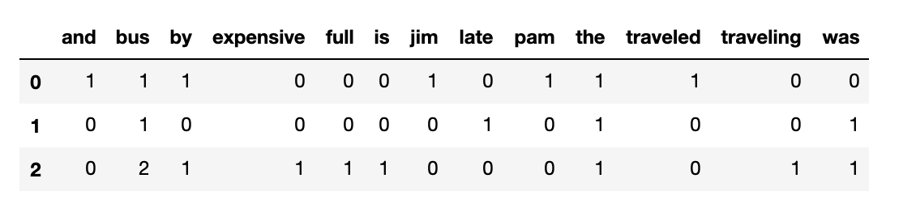
Building a Bag-of-Words
Document 1: Jim and Pam traveled by the bus. Document 2: The bus was late. Document 3: The bus was full. Traveling by bus is expensive.
First, what you do is build a vocabulary matrix. This is every single word that appears in all documents.
Sourced from this article

Slide 6
Building a Bag-of-Words
Document 1: Jim and Pam traveled by the bus. Document 2: The bus was late. Document 3: The bus was full. Traveling by bus is expensive.
Then you just count the frequency each word appears in each document.

Slide 7
Bag-of-Words in python using CountVectorizer
from sklearn.feature_extraction.text import CountVectorizer
documents = [“Jim and Pam traveled by the bus”, “The bus was late.” “The bus was full. Traveling by bus is expensive.”]
cv = CountVectorizer()
X = cv.fit_transform(documents)

Slide 8
Term Frequency - Inverse Document Frequency TF-IDF
General Intuition about TF-IDF
The TF-IDF score shows how important or relevant a term is in a given document.
If a particular word appears multiple times in a document, then it might have higher importance than the other words that appear fewer times (TF).
If a particular word appears many times in a document, but it is also present many times in all documents, then maybe that word is frequent, and therefore not as important. Inverse Document Frequency is used to identify the rare words or important words. (IDF)

Slide 9
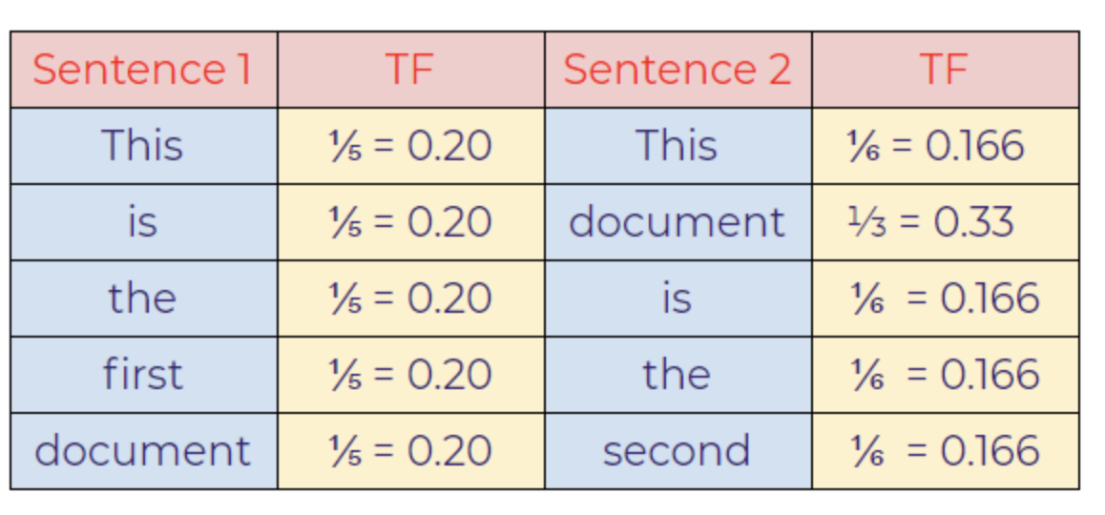
TF-IDF
Document 1: “This is the first document.” Document 2: “This document is the second document.”
Term Frequence (TF) = (Total number of time words appears in sentence) / (Total number of words in the sentence)
* Sourced from this article

Slide 10
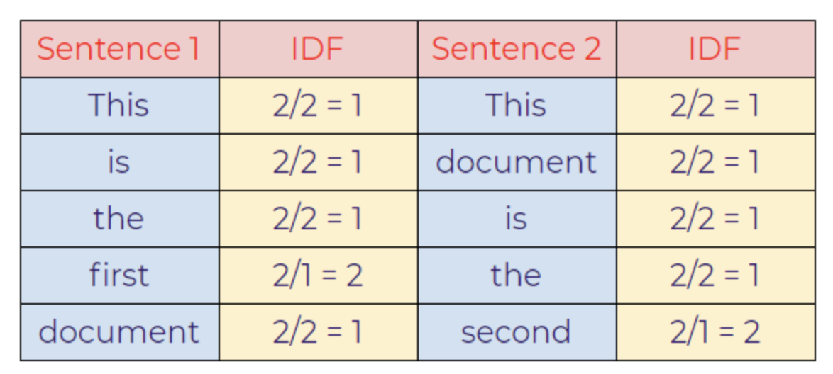
TF-IDF
Document 1: “This is the first document.” Document 2: “This document is the second document.”
Document frequency means what % of documents the word appears in. Then you take the inverse of that by dividing by total number of documents.
Inverse Document Frequency (IDF) = (Total number of documents) / (Number of documents containing that word)

Slide 11
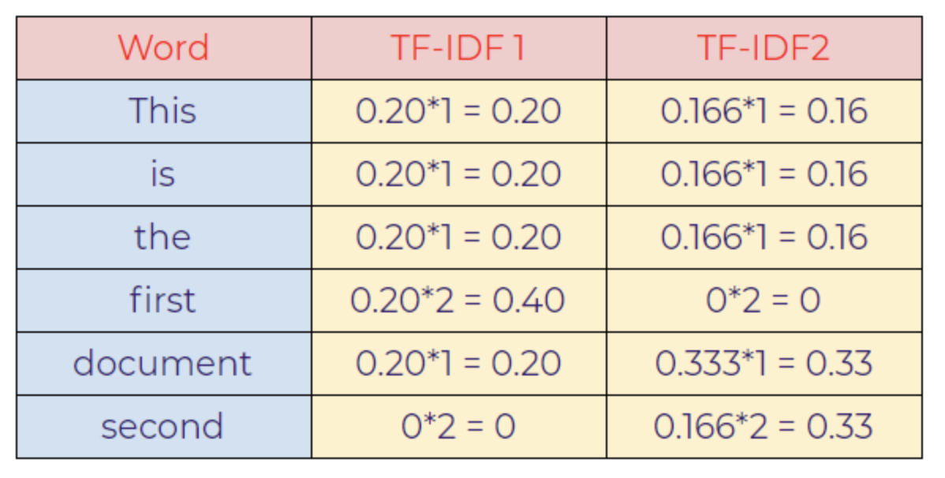
TF-IDF
Document 1: “This is the first document.” Document 2: “This document is the second document.”
TF-IDF = Term Frequency * Inverse Document Frequency
Notice how in the first document, the word “first” has a higher value than the rest of the words. And in the second document, the the word “second” has a higher value than the rest of the words even though they both only appear once in the sentences. And the word “document” has a higher weight in the second document because it appears twice.

Slide 12
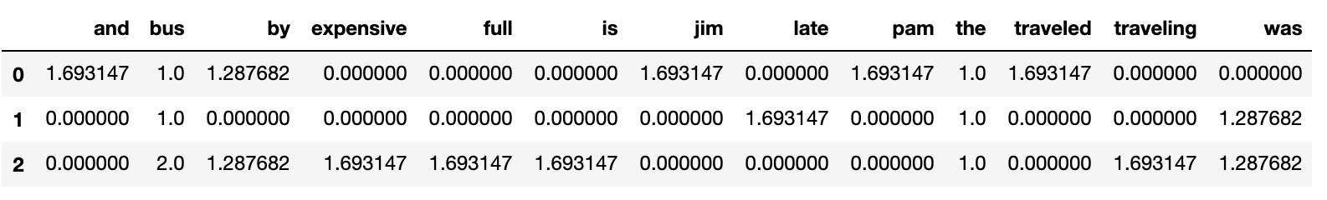
TF-IDF implementation python
from sklearn.feature_extraction.text import TfidfVectorizer
X = ["Jim and Pam traveled by the bus", "The bus was late.", "The bus was full. Traveling by bus is expensive."] vectorizer = TfidfVectorizer() vectorizer.fit(X) X = vectorizer.transform(X)

Slide 13
HUGE FEATURE SPACE
With both BOW and TF-IDF you end up with A LOT OF FEATURES. Again, there is a column for every single word that appears in any of your documents.
The feature space can easily exceed 100,000 columns, even up to 1,000,000 if using bi-grams and tri-grams.

Slide 14
Feature Engineering in NLP

Slide 15
Lowercasing all words.
Making all words lowercase prevent your features from treating the same word differently.
For example: Document 1: The prices are so high. Document 2: Prices went up today.
The words price and Price would be treated as different words unless you lowercased them first. It is good practice to lowercase all your words to prevent this from happening.

Slide 16
Removing Punctuation
Removing punctuation also prevent your features from treating the same word differently.
For example: Document 1: Today cars, boats, and planes were bought. Document 2: Cars and boats were bought today.
The words boats and boats, would be treated as different words as the added ‘,’ at the end of boats would make it a totally new word. However, with removing punctuation, you also lose some information such as !!! or ???. There are arguments for keeping and removing punctuation, it’s more situationally dependent.

Slide 17
Removing Stopwords
Removal of unimportant words in your text corpus can help you reduce your feature space (ie number of columns), which reduces the complexity of your model, which is a good thing :)
['i', 'me', 'my', 'myself', 'we', 'our', 'ours', 'ourselves', 'you', "you're", "you've", "you'll", "you'd", 'your', 'yours', 'yourself', 'yourselves', 'he', 'him', 'his', 'himself', 'she', "she's", 'her', 'hers', 'herself', 'it', "it's", 'its', 'itself', 'they', 'them', 'their', 'theirs', 'themselves', 'what', 'which', 'who', 'whom', 'this', 'that', "that'll", 'these', 'those', 'am', 'is', 'are', 'was', 'were', 'be', 'been', 'being', 'have', 'has', 'had', 'having', 'do', 'does', 'did', 'doing', 'a', 'an', 'the', 'and', 'but', 'if', 'or', 'because', 'as', 'until', 'while', 'of', 'at', 'by', 'for', 'with', 'about', 'against', 'between', 'into', 'through', 'during', 'before', 'after', 'above', 'below', 'to', 'from', 'up', 'down', 'in', 'out', 'on', 'off', 'over', 'under', 'again', 'further', 'then', 'once', 'here', 'there', 'when', 'where', 'why', 'how', 'all', 'any', 'both', 'each', 'few', 'more', 'most', 'other', 'some', 'such', 'no', 'nor', 'not', 'only', 'own', 'same', 'so', 'than', 'too', 'very', 's', 't', 'can', 'will', 'just', 'don', "don't", 'should', "should've", 'now', 'd', 'll', 'm', 'o', 're', 've', 'y', 'ain', 'aren', "aren't", 'couldn', "couldn't", 'didn', "didn't", 'doesn', "doesn't", 'hadn', "hadn't", 'hasn', "hasn't", 'haven', "haven't", 'isn', "isn't", 'ma', 'mightn', "mightn't", 'mustn', "mustn't", 'needn', "needn't", 'shan', "shan't", 'shouldn', "shouldn't", 'wasn', "wasn't", 'weren', "weren't", 'won', "won't", 'wouldn', "wouldn't"]

Slide 18
Stemming / Lemming
Stemming
Simple crude method of breaking down a word into its base.
Plays and playing = play
Lemming
Dictionary based approach that breaks down words into the root meaning.
Brought and bring = bring
automobile and car = car

Slide 19
N-Grams
Total Vocab:
the Prices Are So High Went Up Today (The, prices) (Prices, are) (Are, so) (So, high) (Prices, Went) (Went, Up) (Up, Today)
For example: Document 1: the prices are so high. Document 2: prices went up today.
N-Grams group together adjacent words and treat them as a new word. These new words are used in our BOW and TFIDF algorithms.
Standard is bi-grams, meaning two-adjacent words, however, you can do any amount adjacencies.

Slide 20
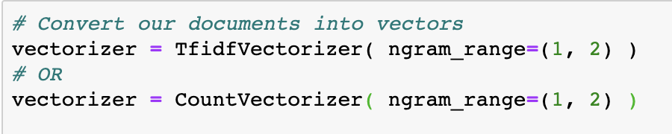
N-Grams in python
Your vectorizer has a nice helper function to automatically incorporate n-grams into your model
Be aware that using n-grams makes your feature space (number of columns) much bigger. With the 20-newsgroups data we will be using today. Using n-grams increased the feature space from 60,000 to 900,000.

Slide 21
Multinomial Naive Bayes
A new classifier

Slide 22
Multinomial Naive Bayes
Multinomial Naive Bayes is a classifier that works well with NLP.
It’s a model that at its heart uses the Bayes’ theorem
It learns to associate word probabilities with each class.
About Naive Bayes:
Super fast and computationally inexpensive.
Works well with a large feature space

Slide 23
Multinomial Naive Bayes
First define your “prior” probabilities for each class.
The prior is the initial guess about the probability that any message, regardless of what that message says, is a given class.
If our training data has 10 Not Spam messages, and 5 Spam messages. Our priors for spam and not spam would be:
P(Not Spam) = 10 / 10 + 5 = 0.66
P(Spam) = 5 / 10 + 5 = 0.33

Slide 24
Multinomial Naive Bayes
Next, for each class you calculate the probably you see the word in that class.
You do that by counting the number of times that word appears in that class and divide that by the total number of words in that class.

Slide 25
Multinomial Naive Bayes
If “college” appears 10 times in Not Spam messages, and there were 100 total words in Not Spam messages:
p( “college” | Not Spam) =
p( “college” | Not Spam) = 10 / 100
p( “college” | Not Spam) = 0.10
If the word “college” appears 5 times in Spam messages and there were a total of 90 words in Spam messages:
p(“college” | Spam) =
p( “college” | Spam) = 5 / 90
p( “college” | Spam) = 0.055

Slide 26
Multinomial Naive Bayes
You do that for every word for both classes.
Not Spam Probabilities:
P( “college” | Not Spam) = 0.10
P(‘tuition’ | Not Spam) = 0.05
P(‘classroom’ | Not Spam) = 0.07
P(‘prince’ | Not Spam) = 0.00
Spam Probabilities:
P( “college” | Spam) = 0.055
P(‘tuition’ | Spam) = 0.015
P(‘classroom’ | Spam) = 0.03
P(‘prince’ | Not Spam) = 0.20

Slide 27
Multinomial Naive Bayes
Now if you want to classify a email that says “college classroom”
Prior(Not Spam) x p(college | Not Spam) x p(classroom | Not Spam)=
(0.66) x (0.10) x (0.07) = 0.00462
Prior(Spam) x p(college | Spam) x p(classroom | Spam)=
(0.33) x (0.055) x (0.03) = 0.00054

Slide 28
Multinomial Naive Bayes
P( college classroom | Not Spam) = 0.00462
P( college classroom | Spam) = 0.00054
Because the score for Not Spam is higher than Spam, the Naive Bayes classifier will classify the message “college classroom” as Not Spam.

Slide 29
To learn more about Multinomial Naive Bayes
StatQuest Video

Slide 30
Onto the live code :)

